Slide 1

EDA Project - Analysis of AMCAT Data

Slide 2
About me
I am an emerging data scientist who recently competed his Masters in Computer Applications with Specialization in Machine Learning. My educational has always been quite average but I think I possess a quality much needed for a Data Science career which is ability to learn quickly and curiosity. I like to work in my comfort zone but more often than not, I like to challenge myself with tasks that seems to be quite interesting.
I want to learn andd excel in Data Science because of mostly two reasons. First, the field of data science has its connections and usability in almost every field out there and secondly it aligns with my dream of using my skills to work in an automotive company like Koenigsegg where they do use engineering to design world’s fastest cars but also rely on massive amonts of data to make that possible. I want to be the one to dive and get insights from that data and also build complex models that can eliminate the use to drivers in a car to such an extent where it would seem like a norm to have a driverless vehicle and experience that same thrill while riding in the passenger seat.
I have 7 months experince as a Subject Matter Expert (SME) at hexaware technologies where I worked in conjunction with the Analytical team by providing them business information to develop models and drive insights from data to improve the business process and solve real world scenarios of customer problems.
Link to Github Repository : LINK

Slide 3
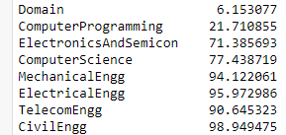
OBJECTIVE
This analysis aims to gain insights and understanding from the provided dataset, particularly focusing on the relationship between various features and the target
variable, which is Salary.
Elaborating the above point,
Importing the data, and providing a brief description.
Checking relationships between several variables by doing Univariate and Bivariate Visual and Non-Visual Analysis.
Checking for outliers and incorrect data in the dataset.
SUMMARY OF THE DATASET
The Aspiring Mind Employment Outcome 2015 (AMEO) dataset, released by Aspiring Minds, focuses on employment outcomes for engineering graduates. It includes dependent variables such as Salary, Job Titles, and Job Locations, along with standardized scores in cognitive skills, technical skills, and personality skills. With around 40 independent variables and 4000 data points, these variables encompass both continuous and categorical data. The dataset also includes demographic features and unique identifiers for each candidate.
DATA CLEANING AND PROCESSING
Dropped the column ‘Unnamed: 0’ as that was a garbage column, dropped the columns 'ID', 'CollegeCityID', 'CollegeID' as they are not relevant to our analysis.
Fixing the data types of some features such ‘DOJ’ and ‘DOL’. These features were of the object type and needed to be converted to datetime format for the analyis.
Feature ‘DOL’ had an unwated value ‘present’. This value indicated that the employee had not yet left the organization and was still a part of it. Replaced that with today’s date. Reason for doing that is that even if this analyis is done in future, the result will be propotionally affected unless and until employee leaves the organization.
Calculating the percentage of unwanted values in some of the columns :
Dropped those columns which had more than 50% of unwanted values.

Slide 4
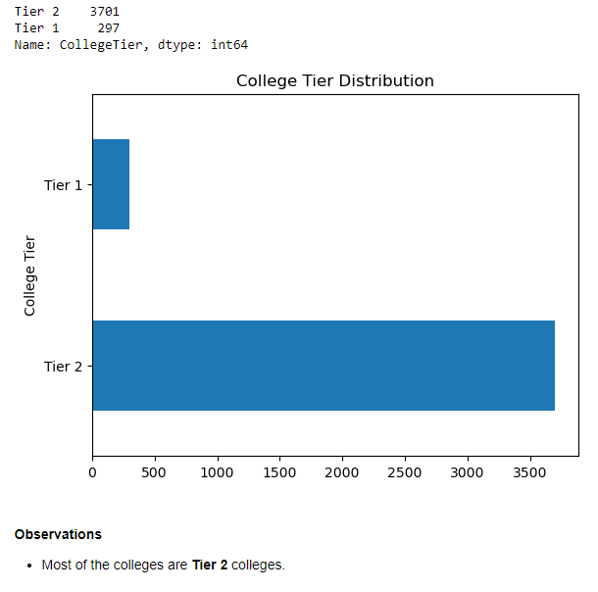
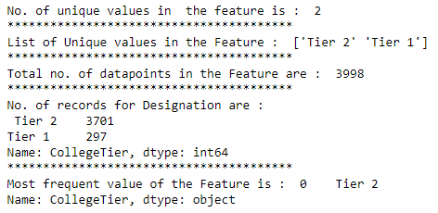
FEATURE ENGINEERING
Generated a feature ‘Age’.
Feature age was a much needed column, as this column gives the actual age of person from which we can check hypothesis like whether significant increase in age has a significant effect on salary earned or not.
Generated a feature ‘Tenure’
Feature Tenure was a much needed column, as this column gives the actual time a person has worked for the organization from which we can check hypothesis like whether significant increase in Tenure has a significant effect on salary earned or not.
EXPLORATORY DATA ANALYSIS (EDA)
Univariate Analysis
Feature CollegeTier : Converted the values 1, 2 to categories Tier 1 & Tier 2 respectively.
Non Visual Visual

Slide 5
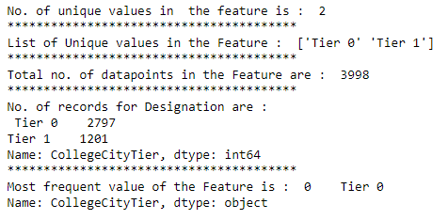
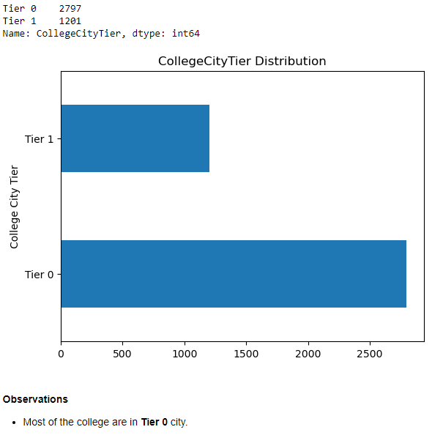
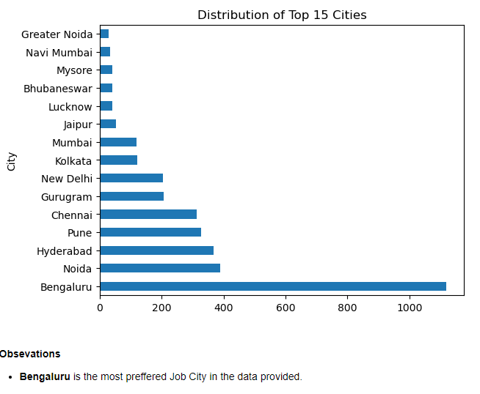
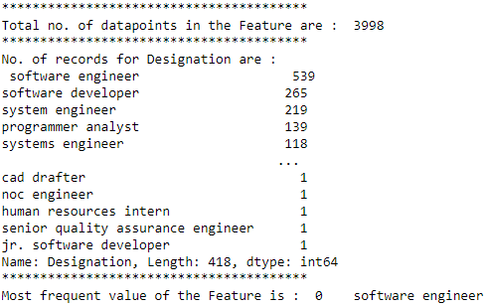
Feature CollegeCityTier : Converted the values 0, 1 to categories Tier 0 & Tier 1 respectively.
Non Visual Visual
Feature JobCity : Replaced the unwanted value ‘get’ with mode of the feature by locating the rows and choosing separate depending upon the specializations.
Non Visual Visual

Slide 6
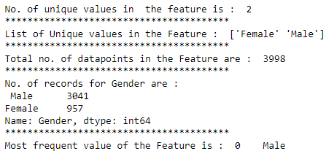
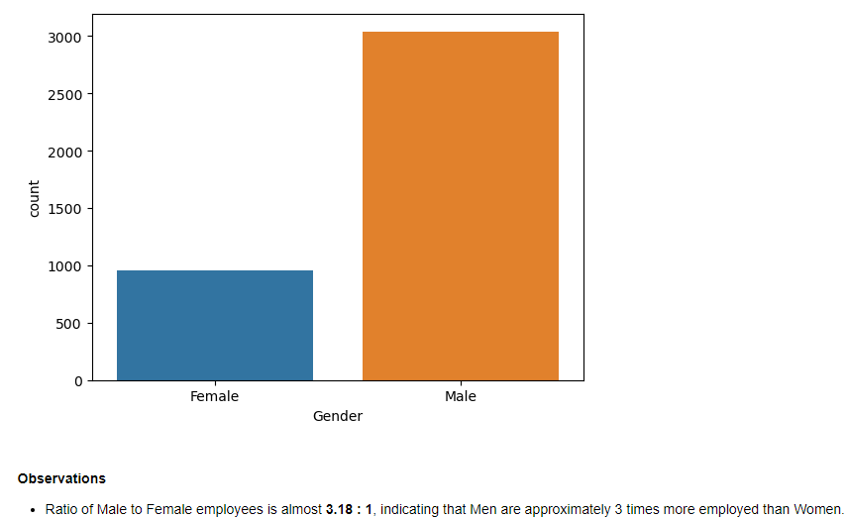
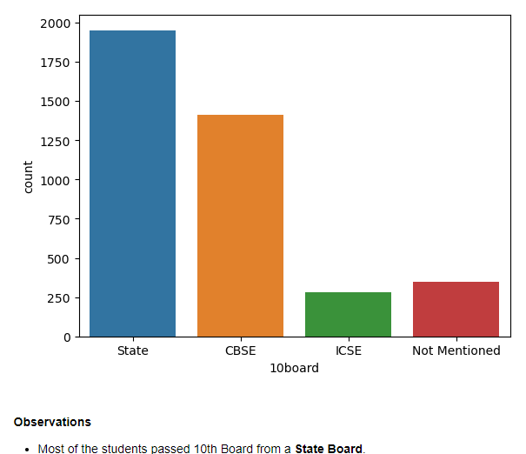
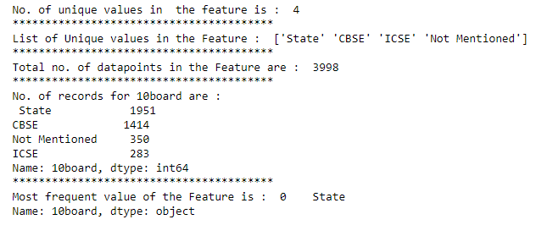
Feature ‘Gender’ : Replaced values ‘m’ and ‘f’ with more descriptive values ‘m’->’Male’ & ‘f’->’Female’
Non Visual Visual
Feature ‘10board’ : Replaced all values into 4 categories, ‘State’ ‘CBSE’ ‘ICSE’ and ‘Not Mentioned’.
Non Visual Visual

Slide 7
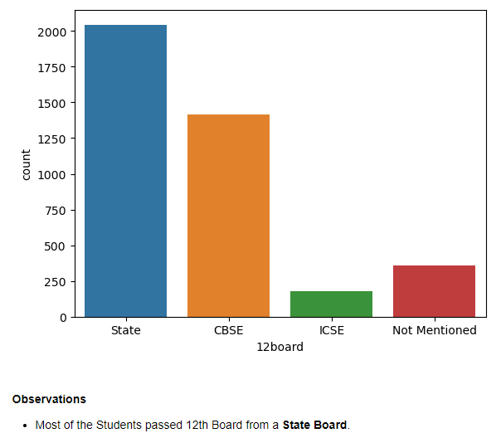
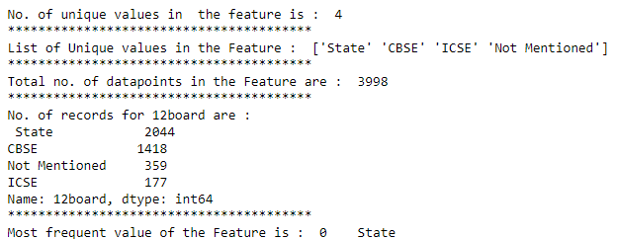
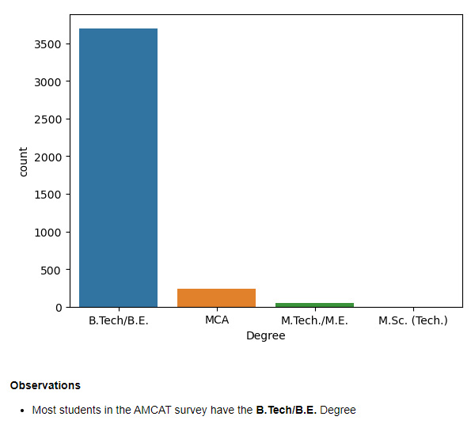
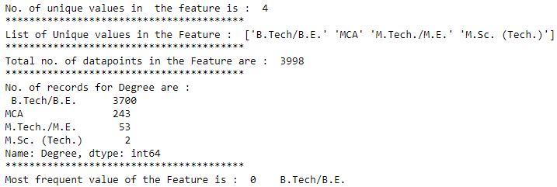
Feature ‘12board’ : Replaced all values into 4 categories, ‘State’ ‘CBSE’ ‘ICSE’ and ‘Not Mentioned’.
Non Visual Visual
Feature ‘Degree’:
Non Visual Visual

Slide 8
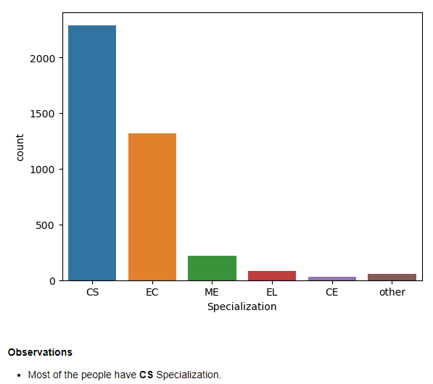
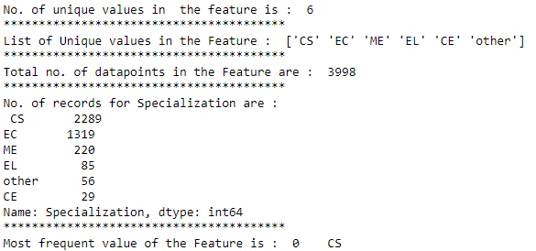
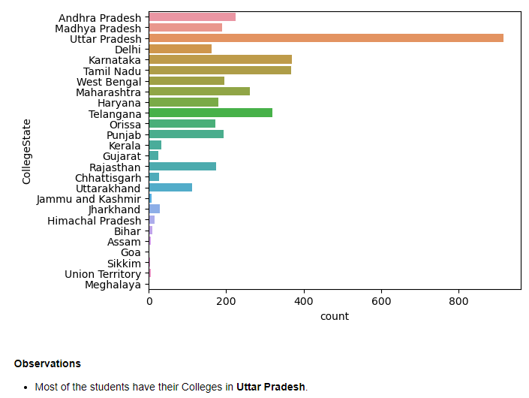
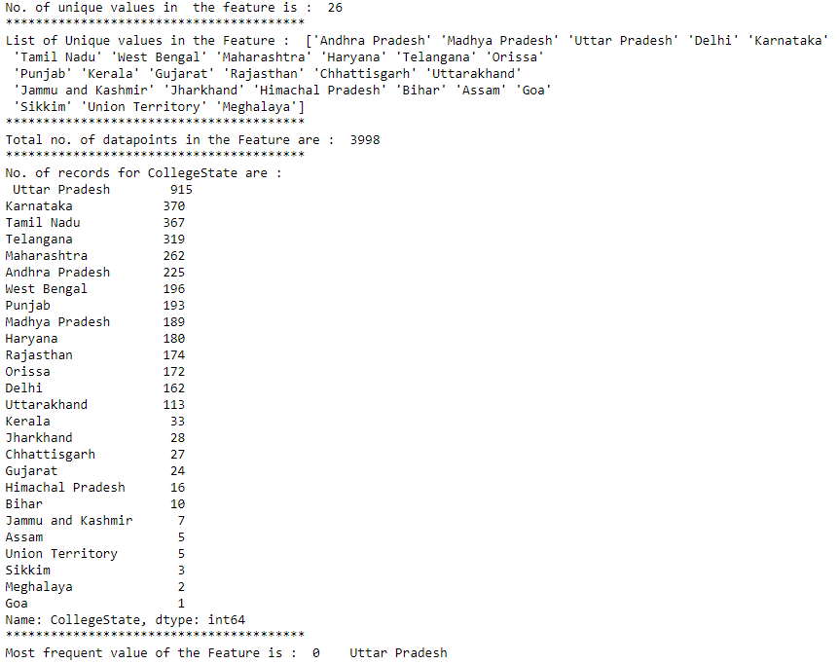
Feature ‘Specialization’: Mapped all specializations to few categories to make the analysis easier.
Non Visual Visual
Feature ‘CollegeState’:
Non Visual Visual

Slide 9
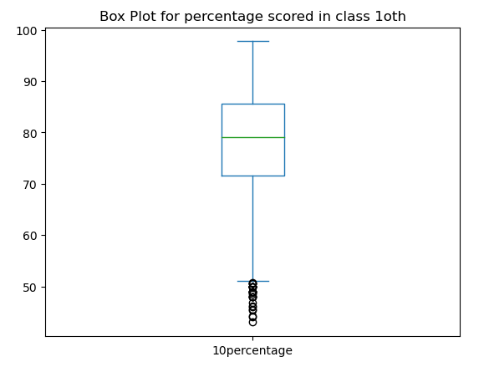
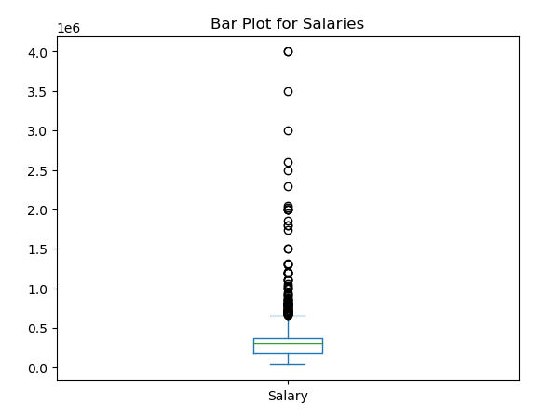
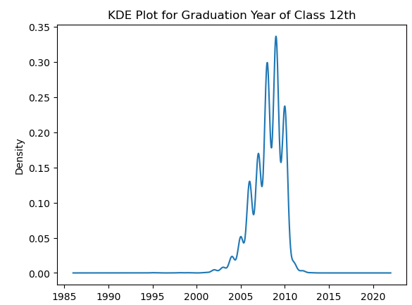
Feature ‘Salary’: This feature had presence of many outliers and most of them were above the 75th percentile mark, indicating there are quite a good number of people having high salaries.
Feature ‘10Percentage’: This feature had presence of many outliers and most of them were below the 25th percentile mark, indicating there are quite a few number of AMCAT aspirants having percentage less than 50%.
Feature 12graduation: This feature had presence of few outliers and most of them were below the 25th percentile mark, indicating there are quite a good number of people who graduated before the year 2003. Also most of the spread of the values was between the range 2003 - 2011.

Slide 10
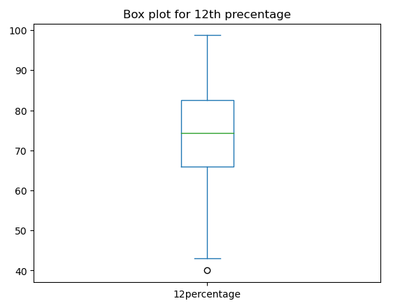
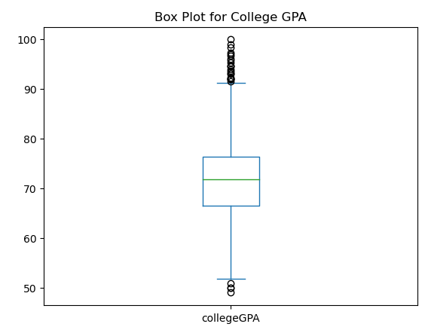
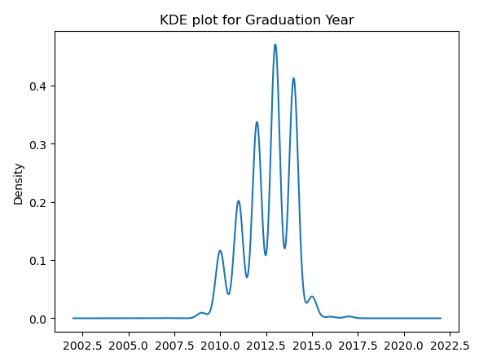
Feature collegeGPA: This feature had presence of many outliers and most of them were concentrated above the 75th percentile mark, indicating there are quite a good number of people having high scores in their college. There was also presence of outliers below the 25th percentile mark indicating few aspirants having low college scores.
Feature ‘12Percentage’: This feature had presence of very few outliers and all of them were below the 25th percentile mark, indicating there were very few few number of AMCAT aspirants having percentage less than 44%.
Feature GraduationYear: This feature had presence of few outliers and all of them were below the 25th percentile mark, indicating there are a fewnumber of people who graduated before the year 2008. Also most of the spread of the values was between the range 2010 - 2015.

Slide 11
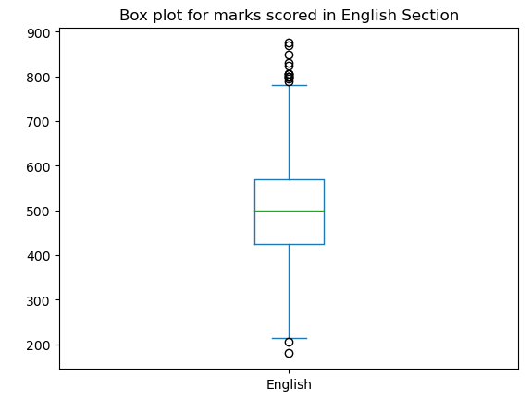
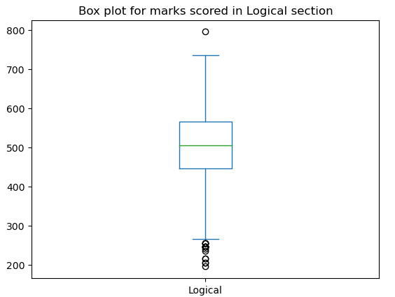
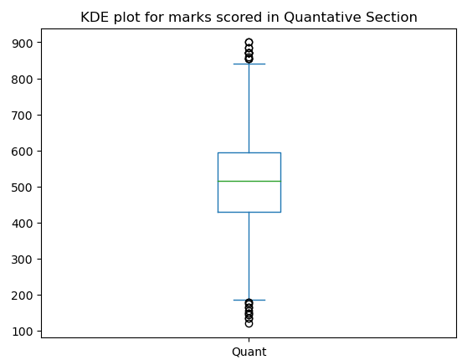
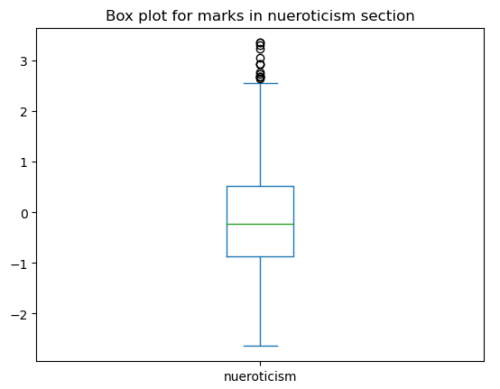
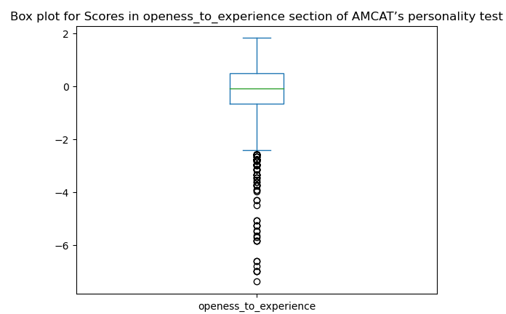
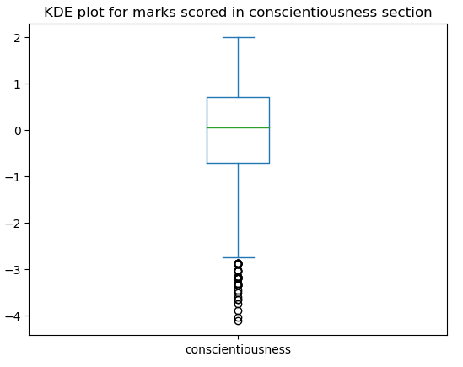
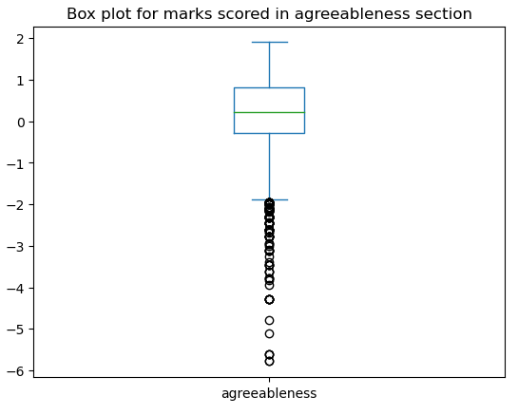
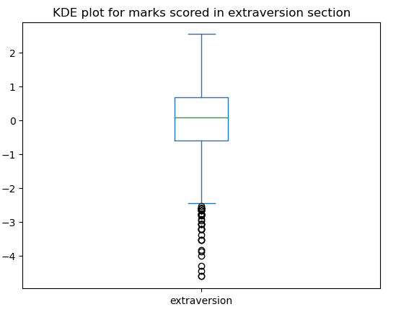
Features English, Logical, Quant: These feature were compulsory for all aspirants to attend in the AMCAT test. For English Section, majority of the outliers were observed in the upper quartile range with very few outliers on the lower end, indicating that more people got scores on the maximum side of total marks. For Logical Section, majority of the outliers were observed in the lower quartile range with very few outliers on the upper end, indicating that more people scored on the lower end of the max score. For Quantitative Section, the outliers were observed for both the upper end and the lower end, indicating that the score distribution was quite even for quantitative section.
For the Personality Test features: These features gauged the personality of the aspirants in the AMCAT test on the parameters, conscientiousness, agreeableness, extraversion, nueroticism and openess_to_experience. Except for nueroticism, all of the features observed scores on the lower side.

Slide 12
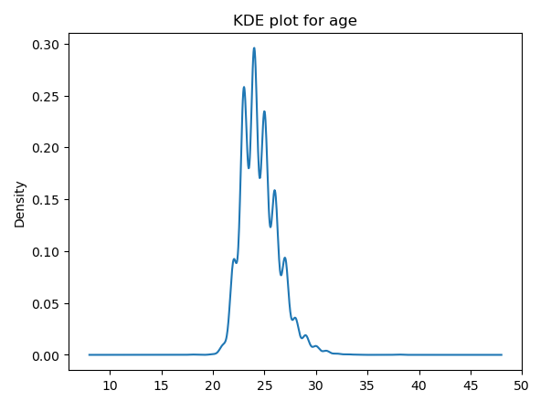
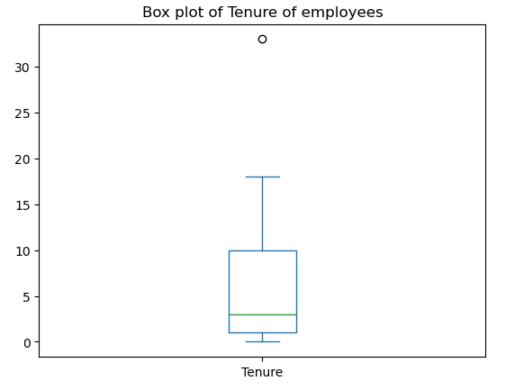
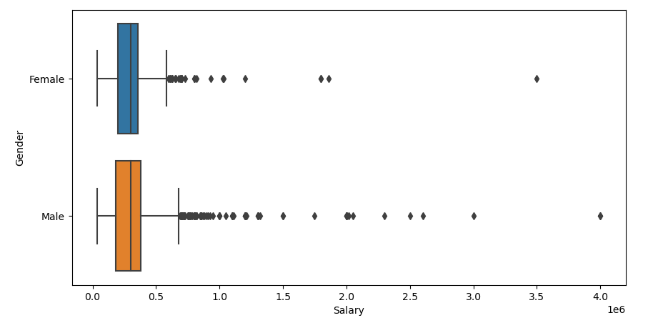
Feature Tenure: This feature had presence of an extreme outlier indicating few people having a large amout of work experience.
Feature Age: This feature had presence of an extreme outlier indicating large variation in the Age distribution. Also most of the values were concentrated in the range 20-30, indicating most of the people surveyed belong to young-middle age group. The analysis also showed that for each age group (2 years) there were many people observed. This indicates that the survey was not saturated with people from a particular age group but greatly distributed throughout the range.
BIVARIATE ANALYSIS
Salary Vs Gender
For this analysis, it was observed that Males are getting paid more as compared to females. It was not like all the highly paid individuals were males but rather the highest paid individual was a male and more outlier concentration was observed in males as compared to females. Their medians were almost equal indicating that 50% of salary distribution is almost not dependent upon the gender type.

Slide 13
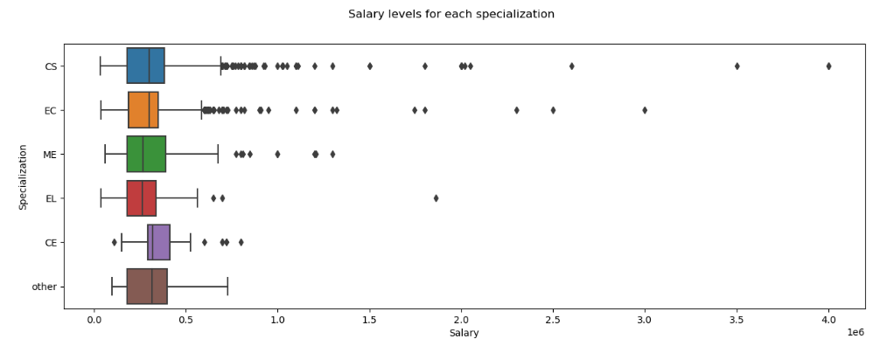
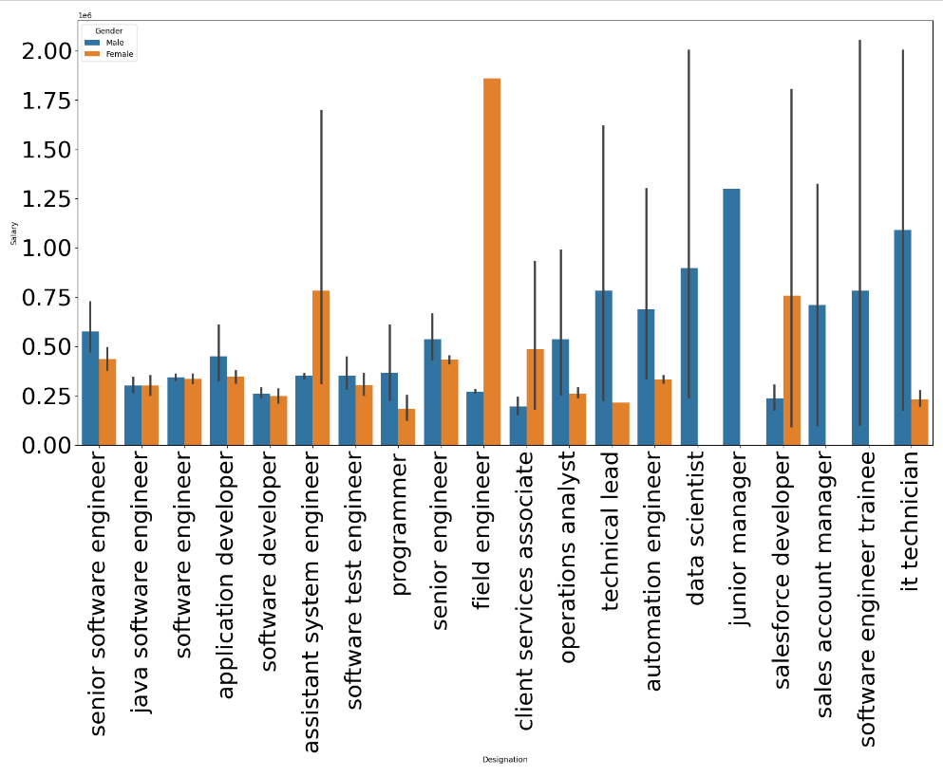
Salary Vs Specialization
From this analysis it was oberved that people with CS and EC specializations are earning significantly more as compared to other specializations. It was also obeserved that more outlier concentration was there for these two specializations indicating higher salaries are earned by people with these specializations. People with Electrical (EL) also has a presence of extreme outlier but its not concentrated and rather an anomaly.
Salary Vs Designations (with gender split)
From this analysis it was oberved that people with designations in IT domain are getting paid more and Software Enginner and Software Developer are most frequent and highest paid jobs. Also it was observed that except field engineer, client services associate, salesforce developer and assistant system engineer other designations have males earning more than females. This exception may be because tenurity, organization policies etc. whose data is not available at the time of the analysis.

Slide 14
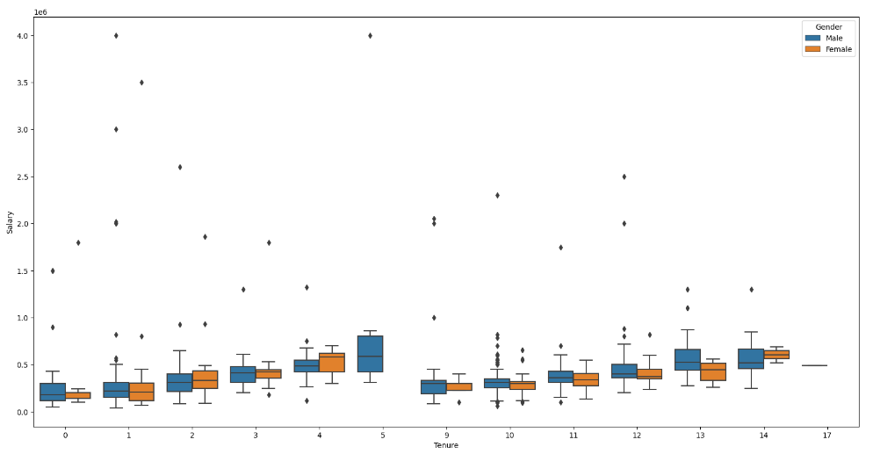
Salary Vs Tenure (with gender split)
From this analysis it was oberved that median salary of both males and females have increased slightly with experience for first five years and decreased suddenly on the 6th year and then same pattern for the following years. Also it was observed that that males and females having same experience are paid nearly equally around 3.5-5 lakhs

Slide 15
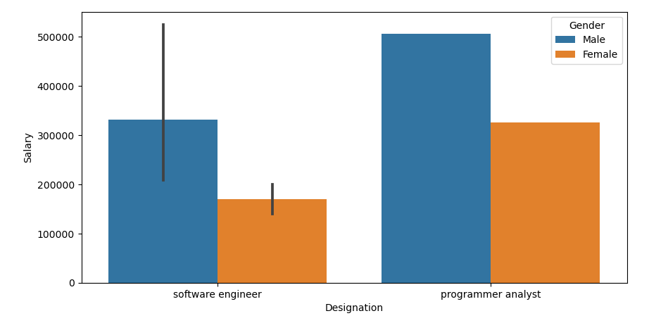
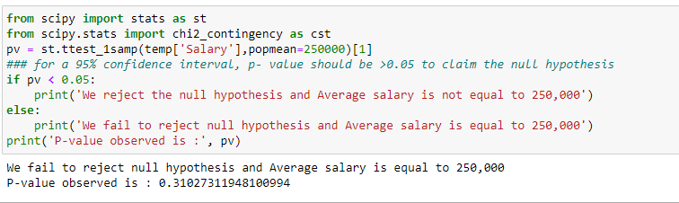
Research Questions
“ Times of India article dated Jan 18, 2019 states that “After doing your Computer Science Engineering if you take up jobs as a Programming Analyst, Software Engineer, Hardware Engineer and Associate Engineer you can earn up to 2.5-3 lakhs as a fresh graduate.” Test this claim with the data given to you. ”
To test this claim we first plotted a graph with the available designations ( designations "hardware engineer","associate engineer" were not available, therefore claim for these two designations could not be tested). From the graph it was observed that male were earning more as a fresher as compared to females and the claim was indeed true.
To further solidify the claim result, a One sample T-test was conducted and the p-value that was observed was approximately 0.31 which was more than enough than threshold of 0.05 to reject the null hypothesis that Average salary is not equal to 2.5 lakhs

Slide 16
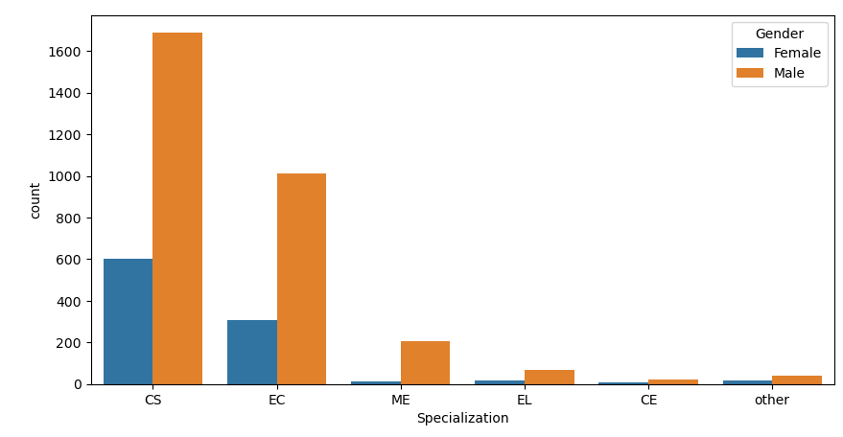
“ Is there a relationship between gender and specialization? (i.e. Does the preference of Specialisation depend on the Gender?)”
To test this hypothsis we first plotted a graph of specializations Vs Gender. But not much was clear as from the graph almost all specializations were dominated be females. If this was concluded we might face a bias, to clear this out one more test was carried out.
Test | Value
chi2_critical | 12
chi2_statistic | 49.57240850719073
chi2_p_value | 1.660622314286101e-06
To solidify the claim result, an analysis conducted using a Chi-Square test examined the relationship between gender and specialization preferences. The test revealed a statistically
significant relationship between the two variables, indicating that specialization preferences are dependent on gender.
The calculated chi2_statistic exceeded the critical value, and the p-value was significantly less than the chosen significance level, leading to the rejection of the null hypothesis. Therefore, there is
sufficient evidence to conclude that gender and specialization are related, suggesting that certain fields may be more preferred or accessible to individuals of particular genders. This finding underscores the importance of considering gender diversity and inclusivity in various fields and
highlights potential barriers or biases that may exist in certain specializations.

Slide 17
Conclusion
The extensive data analysis yields several notable discoveries about the factors impacting pay levels in the dataset. While certain criteria, such as tenure and college level, have a strong link with compensation, others, such as gender and academic performance, have no relationship.
Senior Software Engineers demand the greatest incomes, but with greater unpredictability, while Software Developers and Technical Support Engineers make less than the average. Gender does not appear to play a large impact in income determination on average, yet females do receive less than the total average salary. Academic performance, as measured by 10th, 12th, and college GPA scores, does not clearly correlate with pay levels. After removing outliers, age does not appear to be a determining factor in compensation.

Slide 18

THANK YOU

